Slide 1
Functional Programming
Joy Chakraborty
joychak1@[yahoo|gmail].com

Slide 2

X = X + 1

Slide 3
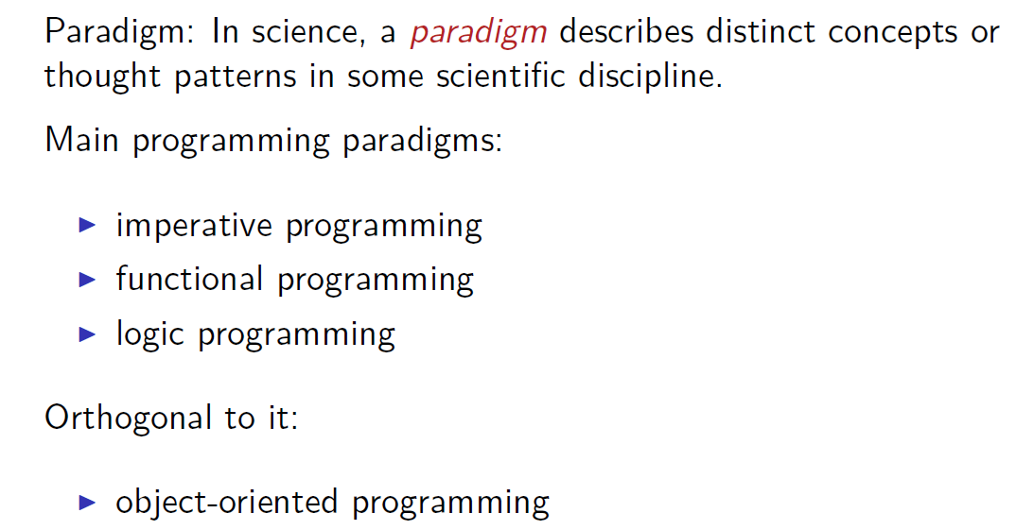
Programming Paradigms

Slide 4
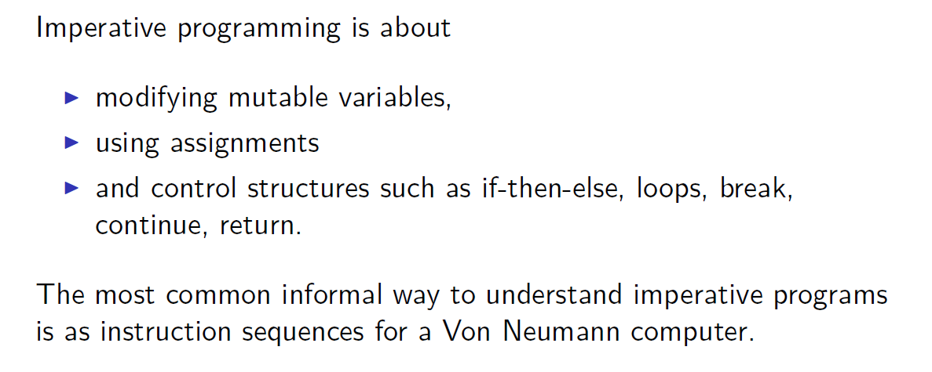
Imperative programming

Slide 5
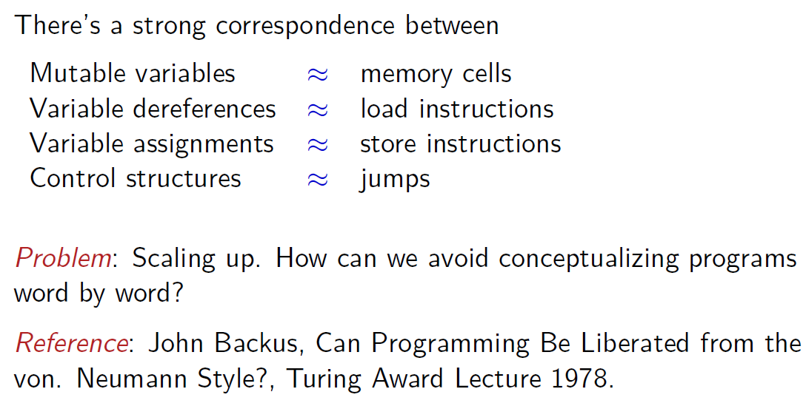
Imperative Programs and Computers

Slide 6
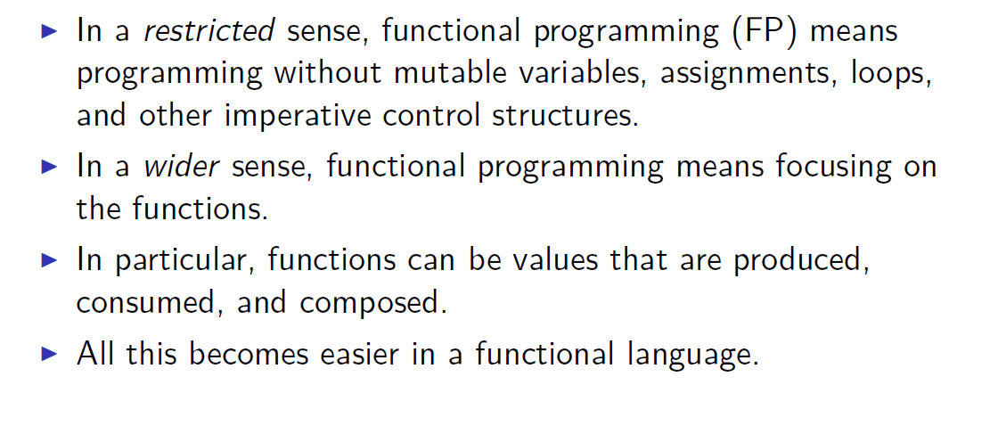
Functional Programming

Slide 7
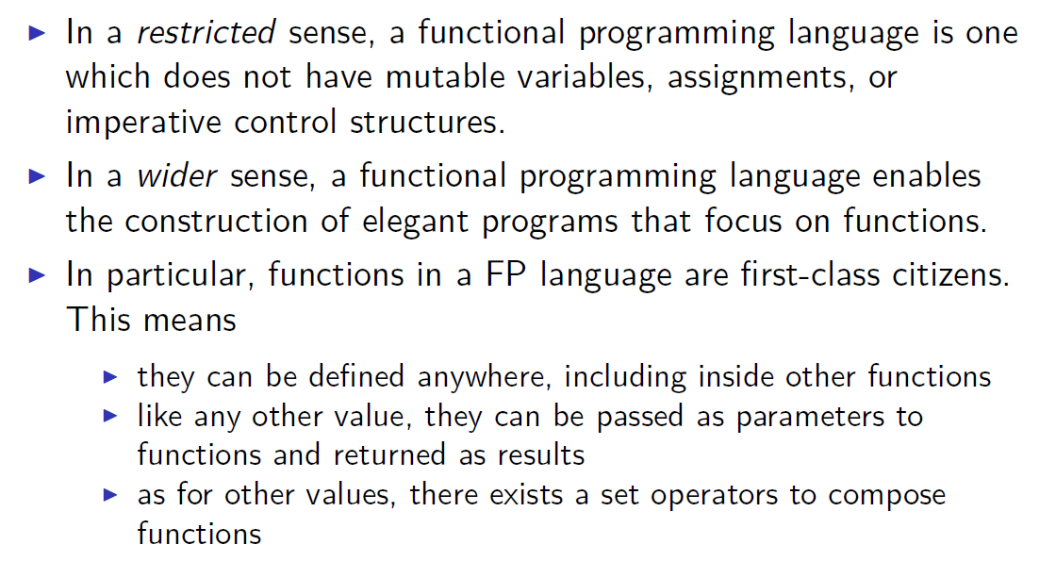
Functional Programming Languages

Slide 8
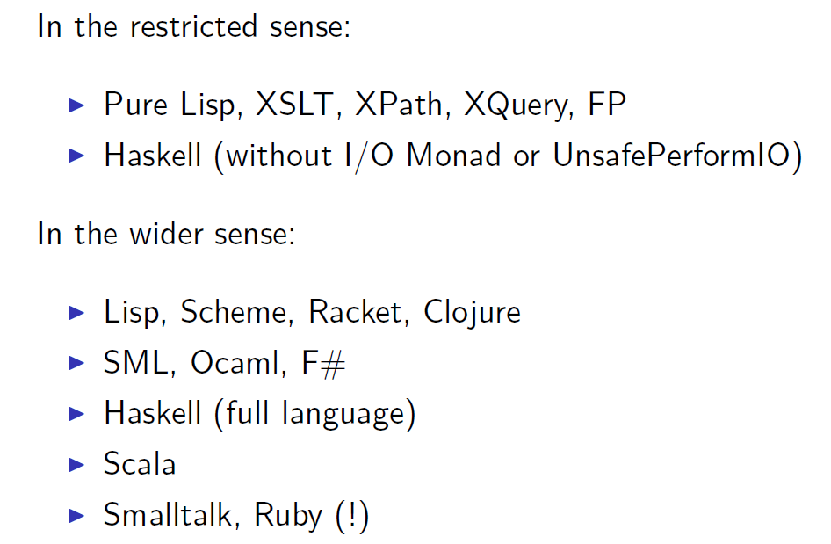
Some functional programming languages

Slide 9

2003
http://www.scala-sbt.org/download.html

Slide 10
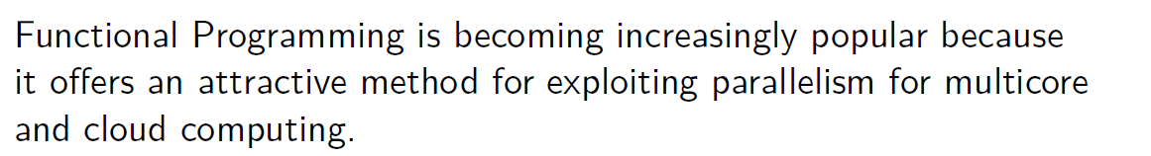
Why Functional Programming?

Slide 11
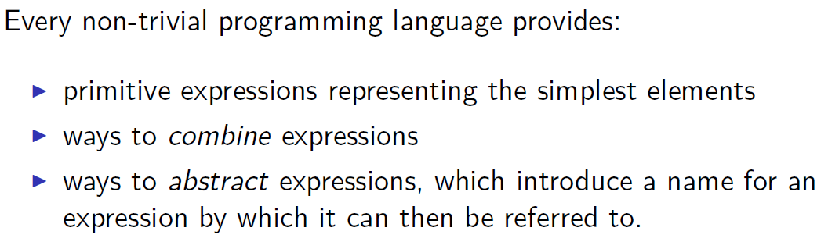
Elements of Programming

Slide 12
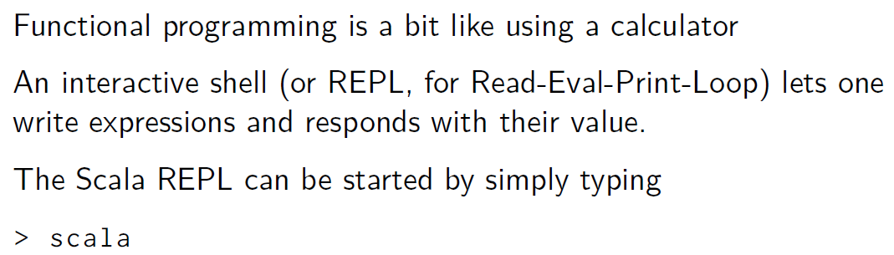
The Read-Eval-Print Loop

Slide 13
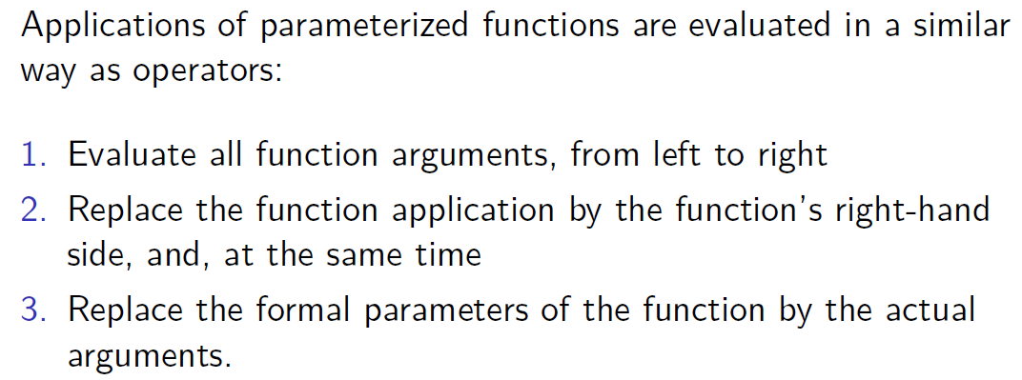
Evaluation of Function Applications

Slide 14
Evaluation - Example
sumOfSquares(3, 2+2)

Slide 15
Evaluation - Example
sumOfSquares(3, 2+2)
sumOfSquares(3, 4)

Slide 16
Evaluation - Example
sumOfSquares(3, 2+2)
sumOfSquares(3, 4)
square(3) + square(4)

Slide 17
Evaluation - Example
sumOfSquares(3, 2+2)
sumOfSquares(3, 4)
square(3) + square(4)
3 * 3 + square(4)

Slide 18
Evaluation - Example
sumOfSquares(3, 2+2)
sumOfSquares(3, 4)
square(3) + square(4)
3 * 3 + square(4)
9 + square(4)

Slide 19
Evaluation - Example
sumOfSquares(3, 2+2)
sumOfSquares(3, 4)
square(3) + square(4)
3 * 3 + square(4)
9 + square(4)
9 + 4 * 4

Slide 20
Evaluation - Example
sumOfSquares(3, 2+2)
sumOfSquares(3, 4)
square(3) + square(4)
3 * 3 + square(4)
9 + square(4)
9 + 4 * 4
9 + 16

Slide 21
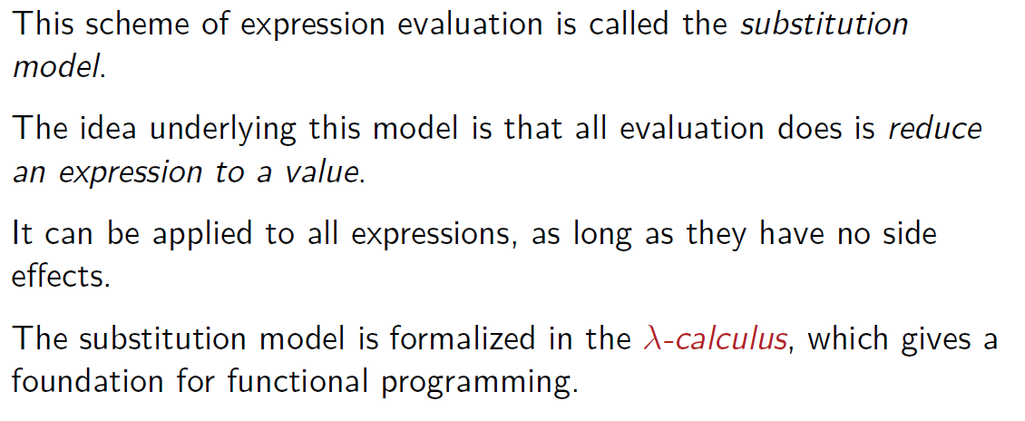
The substitution model

Slide 22
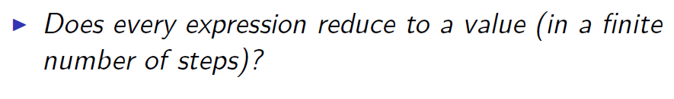
Termination

Slide 23
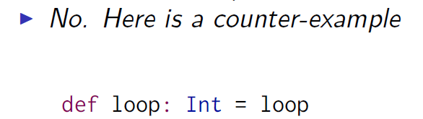
Termination

Slide 24
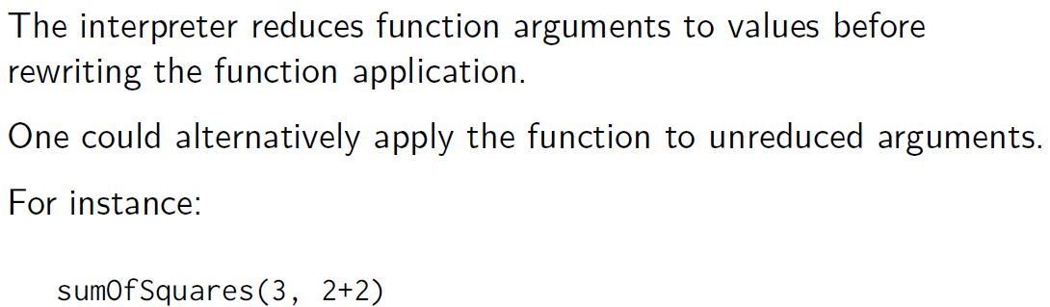
Changing the evaluation strategy

Slide 25
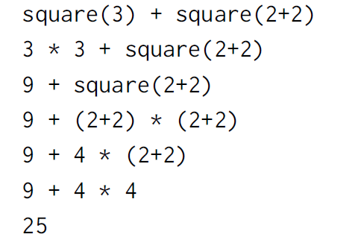
Changing the evaluation strategy

Slide 26
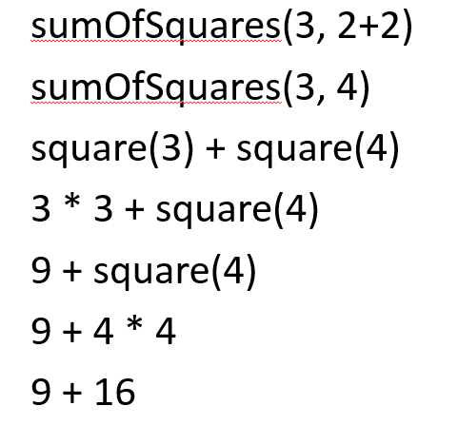
Changing the evaluation strategy

Slide 27
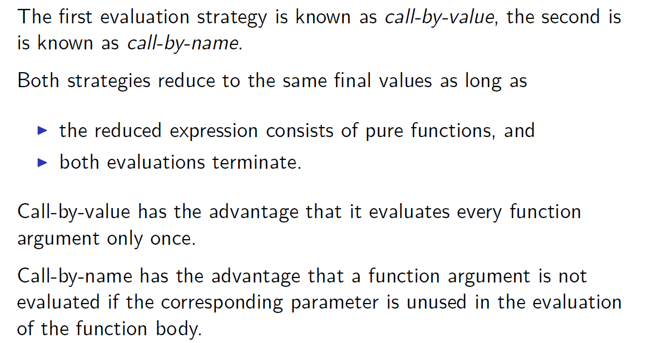
Call-by-name and call-by-value

Slide 28
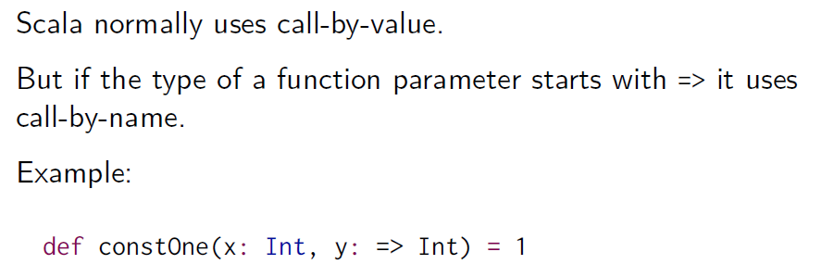

Scala’s evaluation strategy

Slide 29
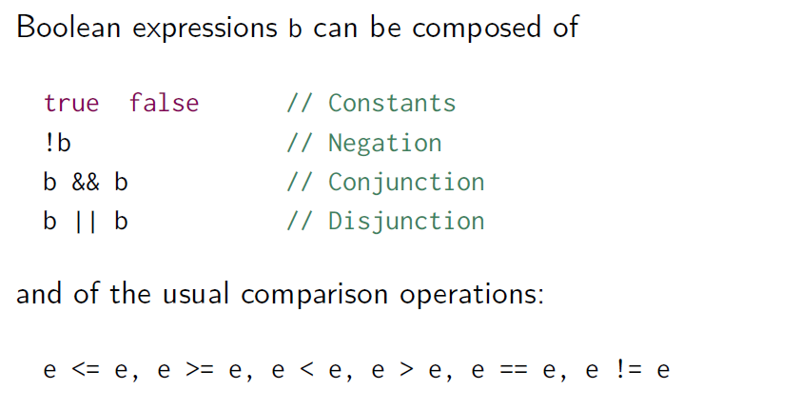
Boolean Expressions

Slide 30
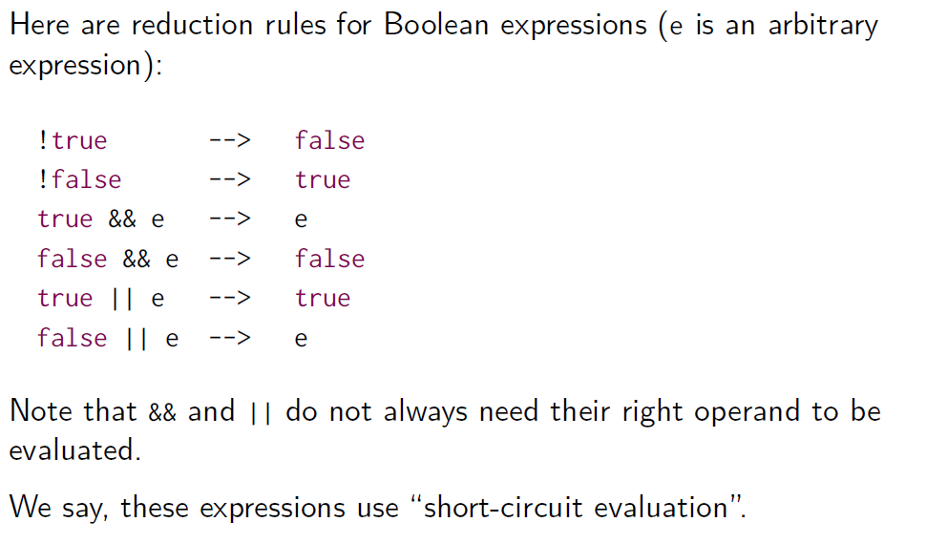
Rewrite rules for Booleans

Slide 31
Function is everywhere !!!

Slide 32
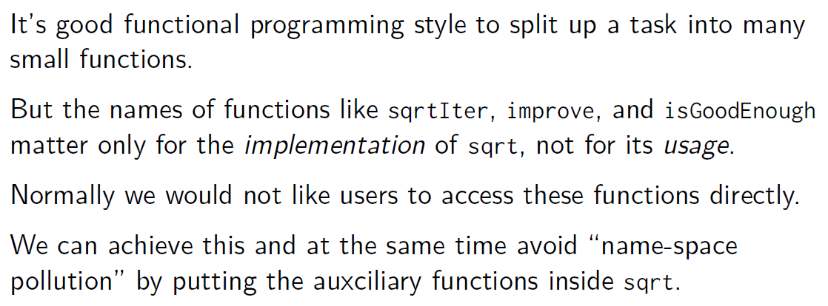
Nested functions

Slide 33
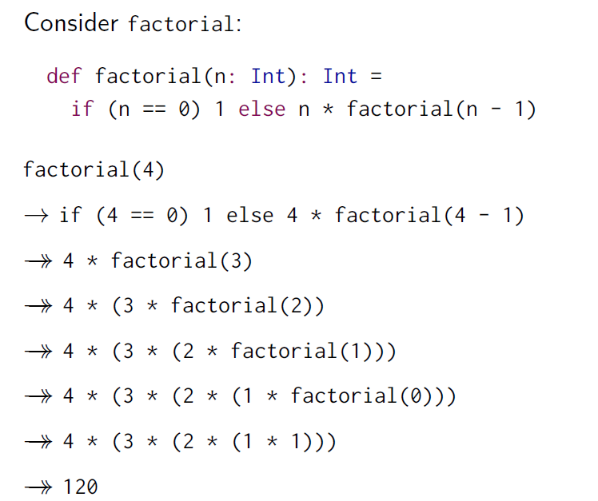
Tail Recursion

Slide 34

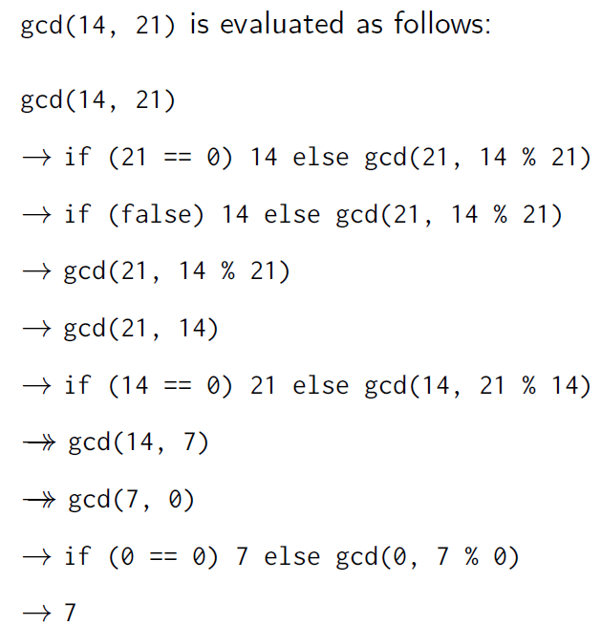
Tail Recursion

Slide 35
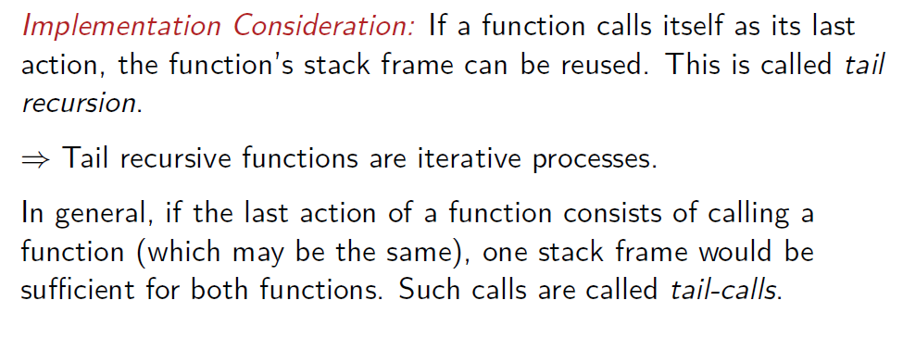
Tail Recursion

Slide 36
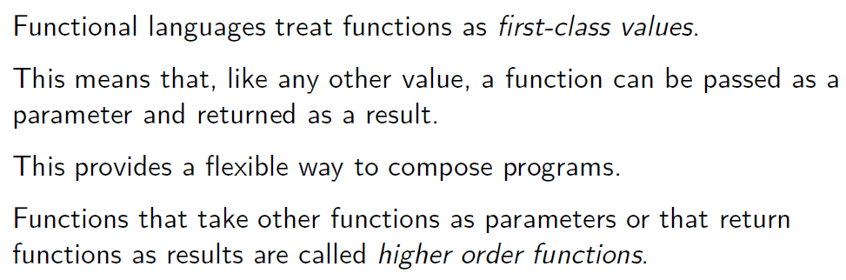
Higher-Order Functions

Slide 37
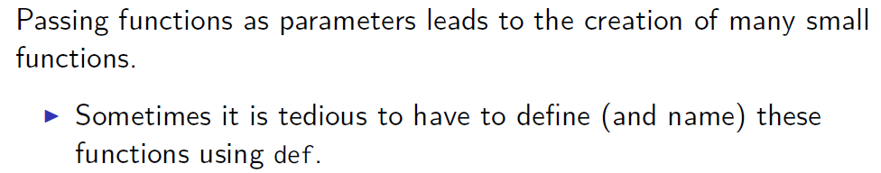
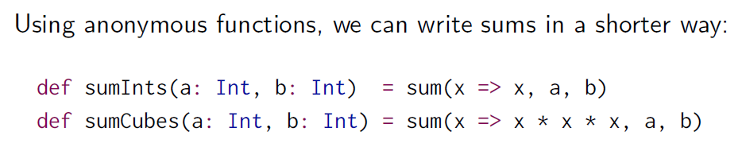
Anonymous Functions

Slide 38
Object Orientation!!!

Slide 39
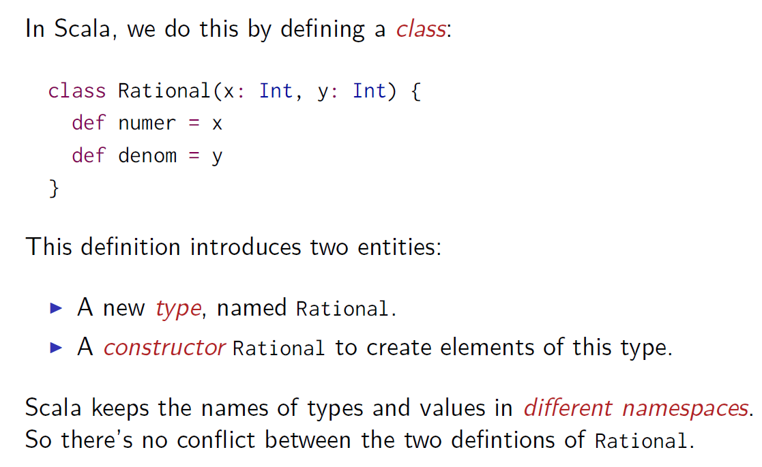
Object Orientation

Slide 40
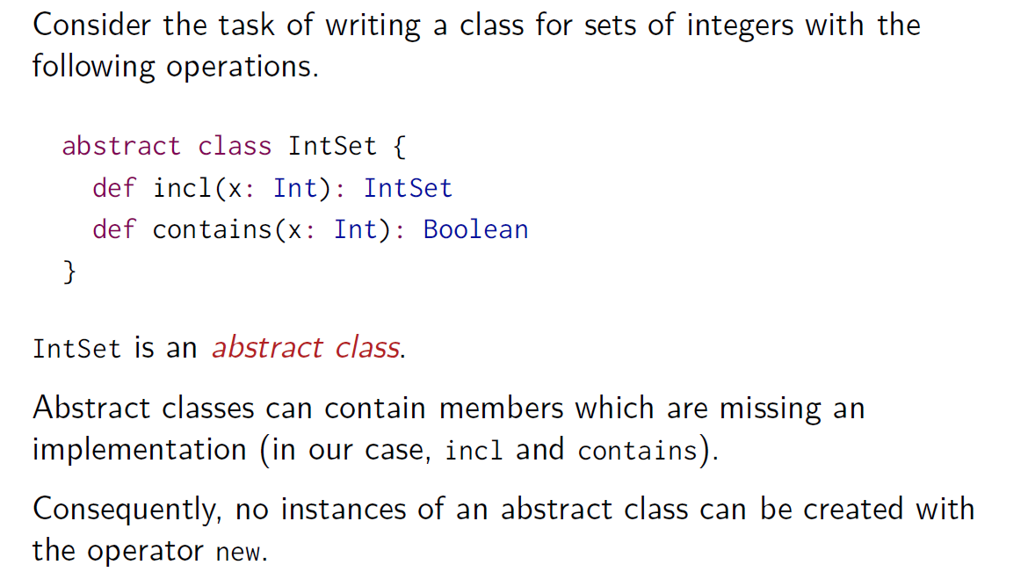
Abstract Classes

Slide 41
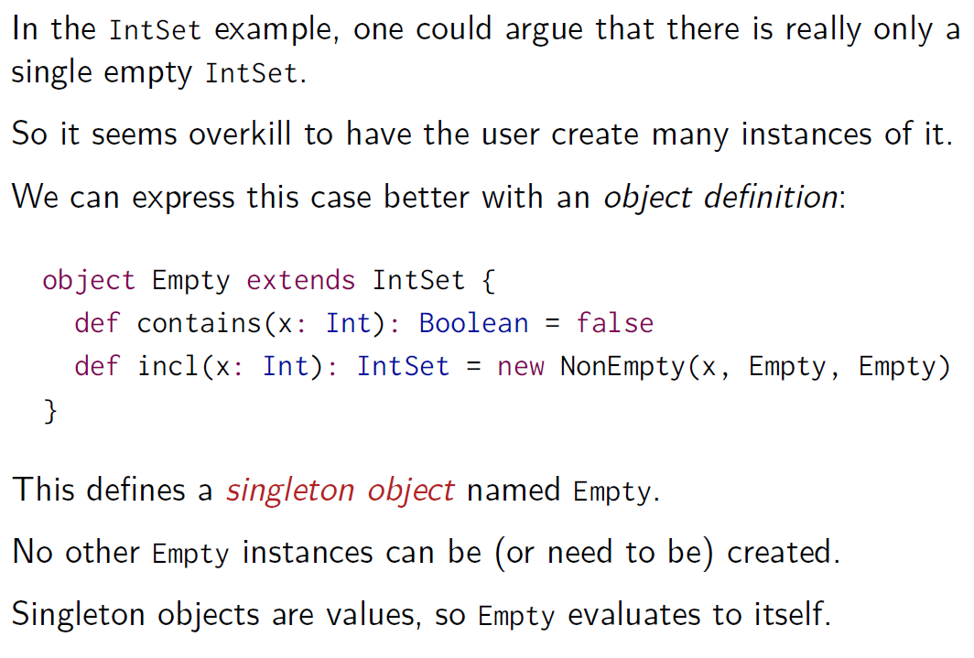
Object Definitions

Slide 42
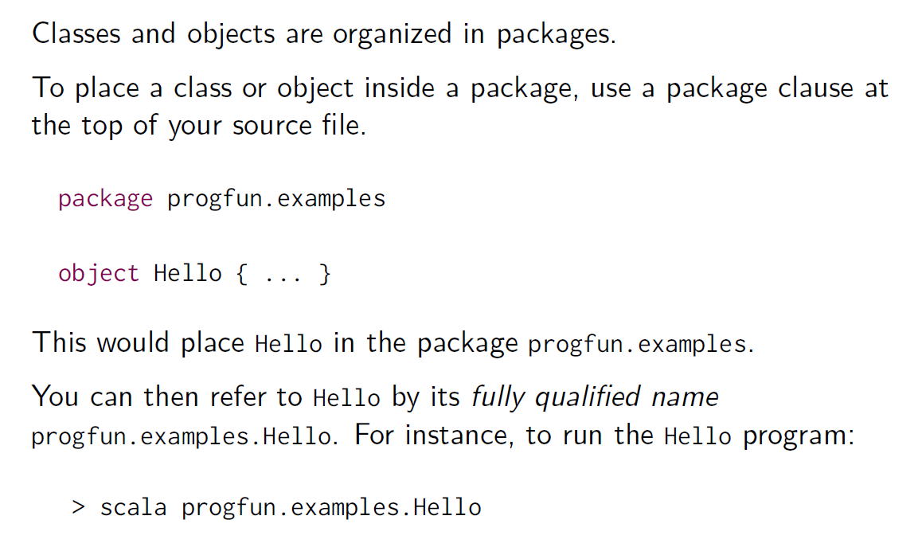
Packages

Slide 43
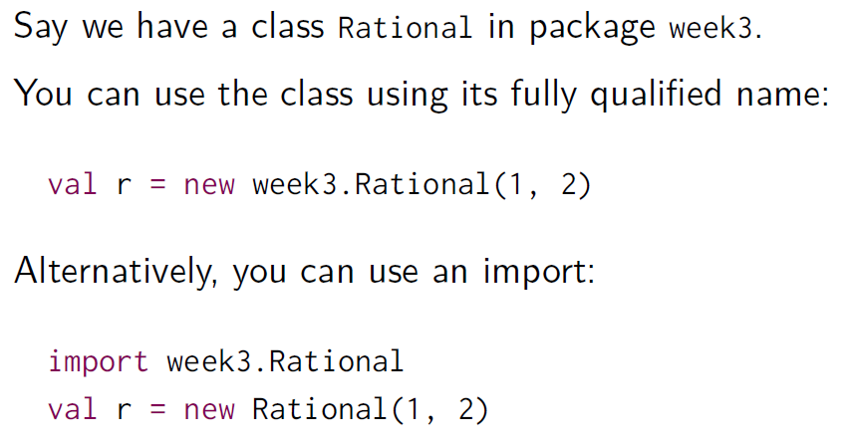
Imports

Slide 44

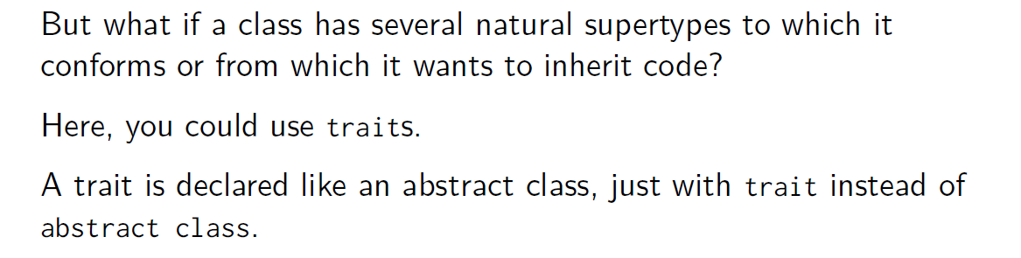
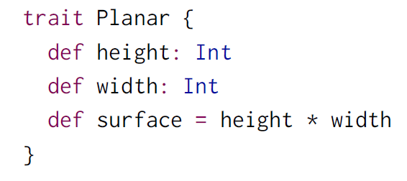
Traits

Slide 45
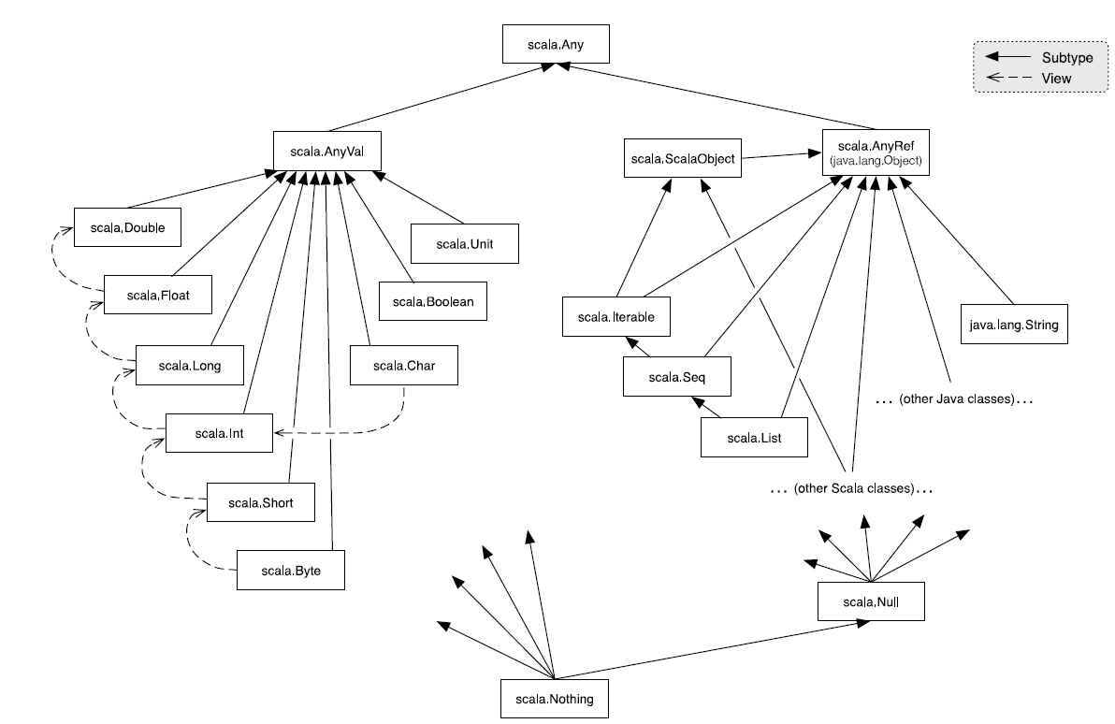
Scala’s Class Hierarchy

Slide 46
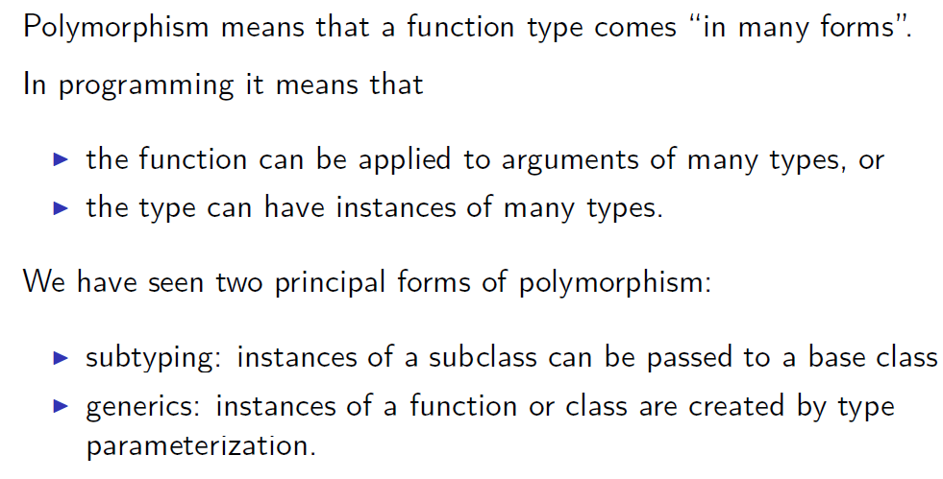
Generics

Slide 47
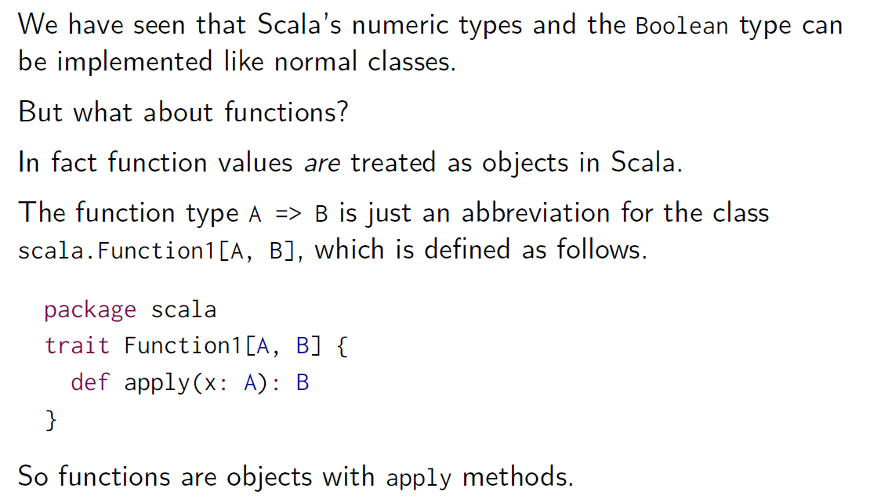
Functions as Objects

Slide 48
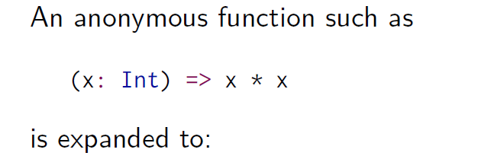
Expansion of Function Values

Slide 49
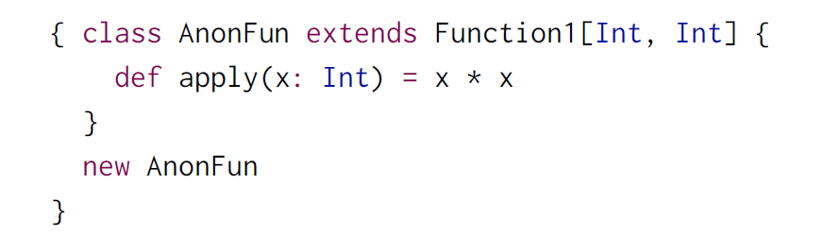
Expansion of Function Values

Slide 50
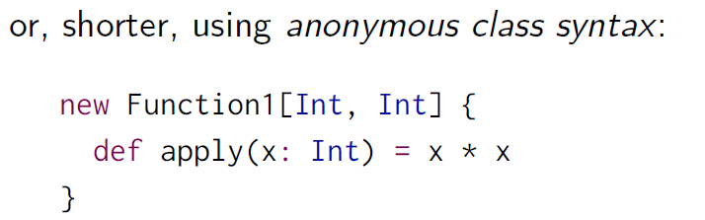
Expansion of Function Values

Slide 51
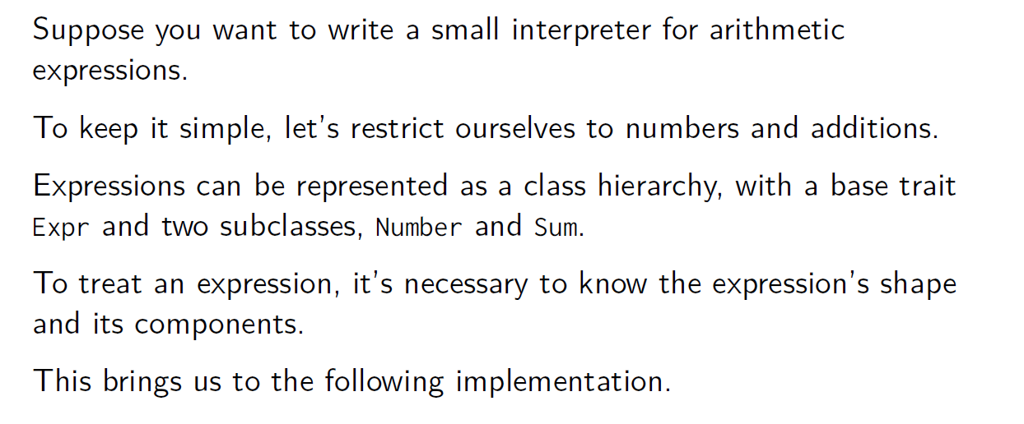
Decomposition

Slide 52
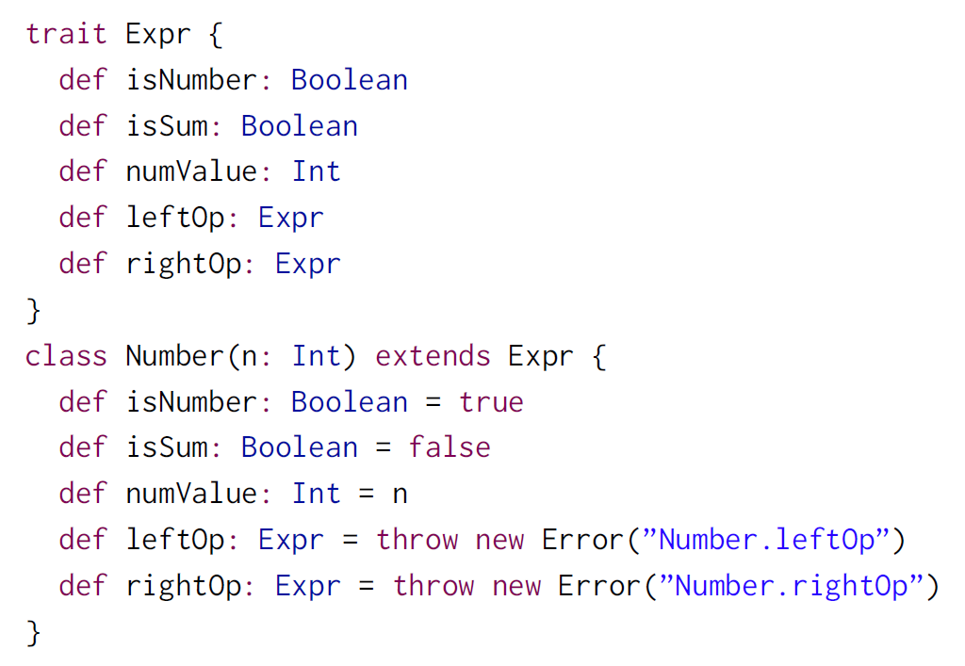
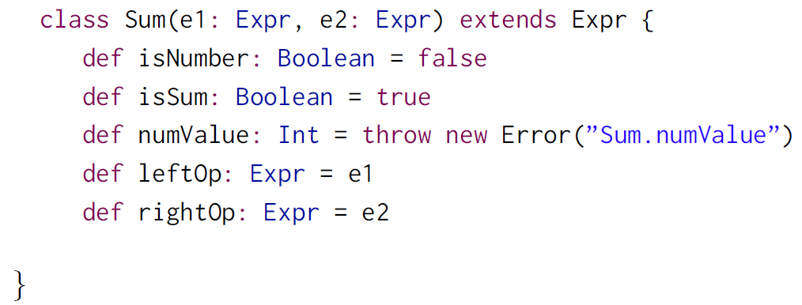
Expressions

Slide 53
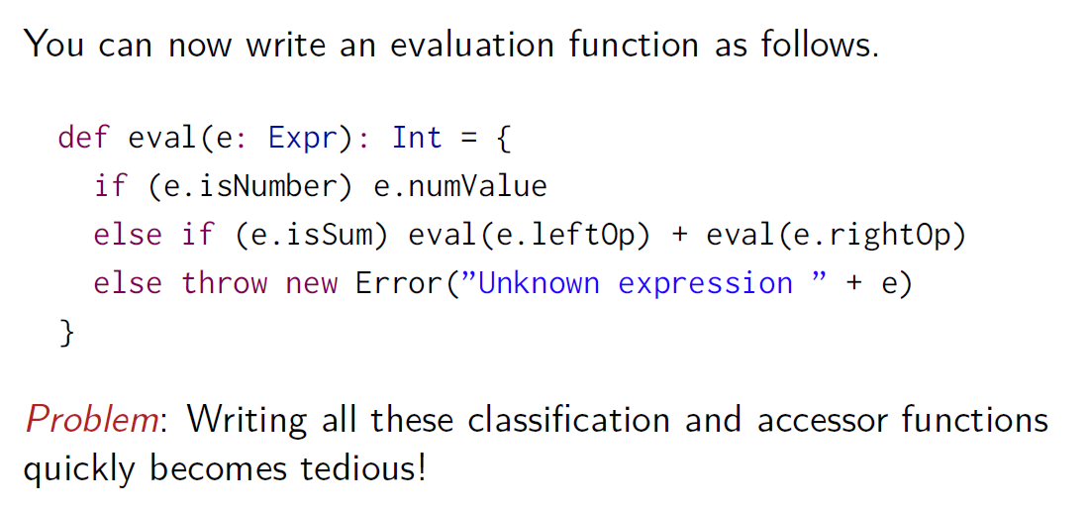
Evaluation of Expressions

Slide 54
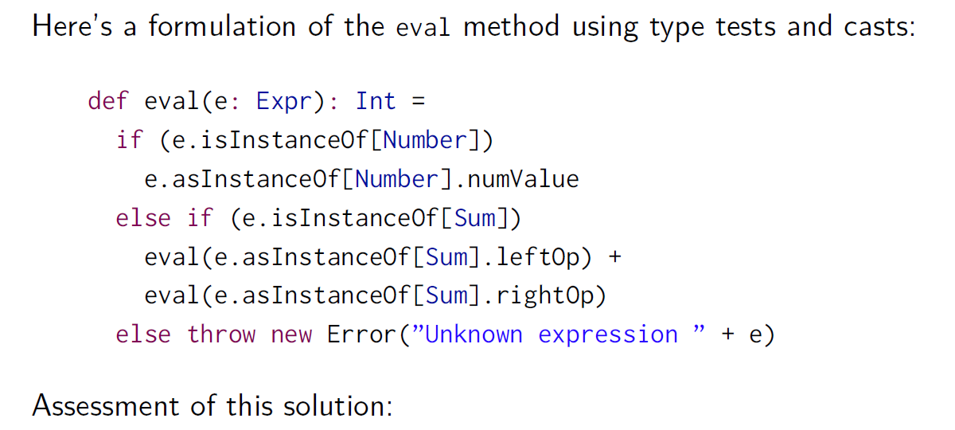
Eval with Type Tests and Type Casts

Slide 55
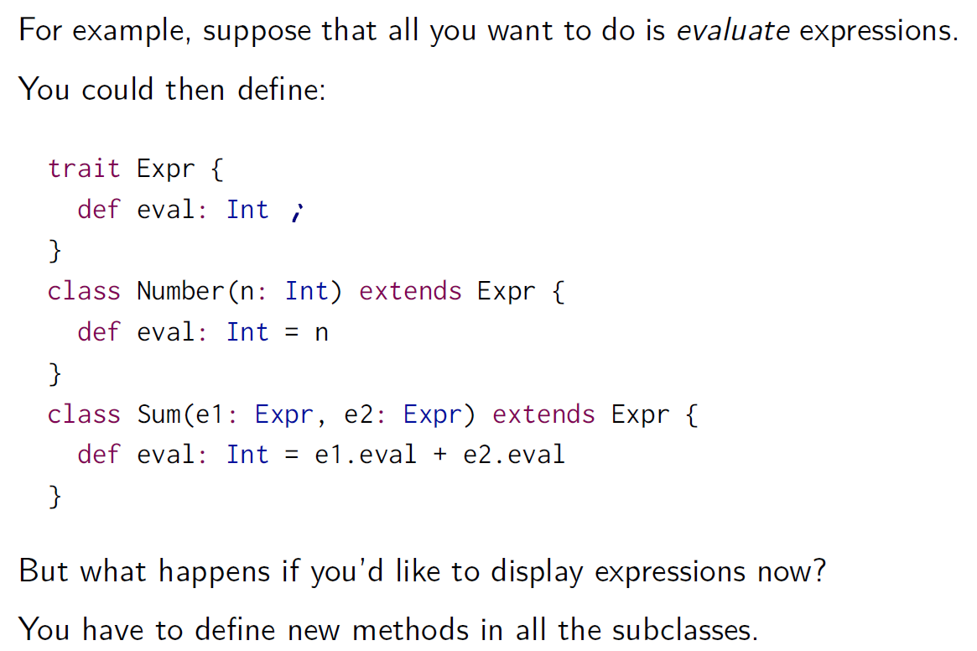
Solution 1: Object-Oriented Decomposition

Slide 56
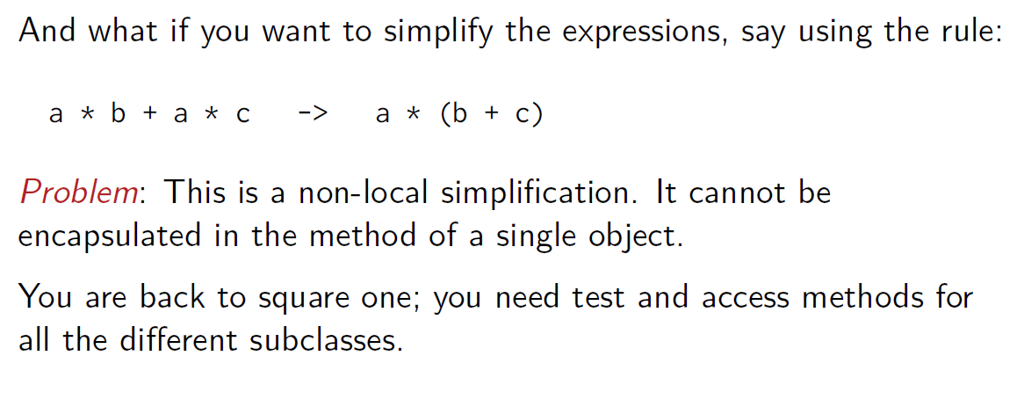
Limitations of OO Decomposition

Slide 57
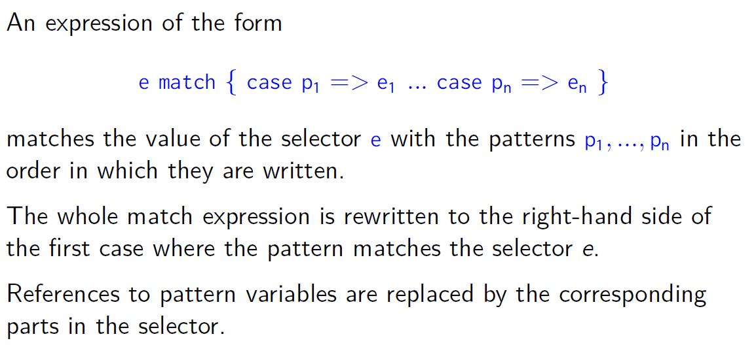
Evaluating Match Expressions

Slide 58
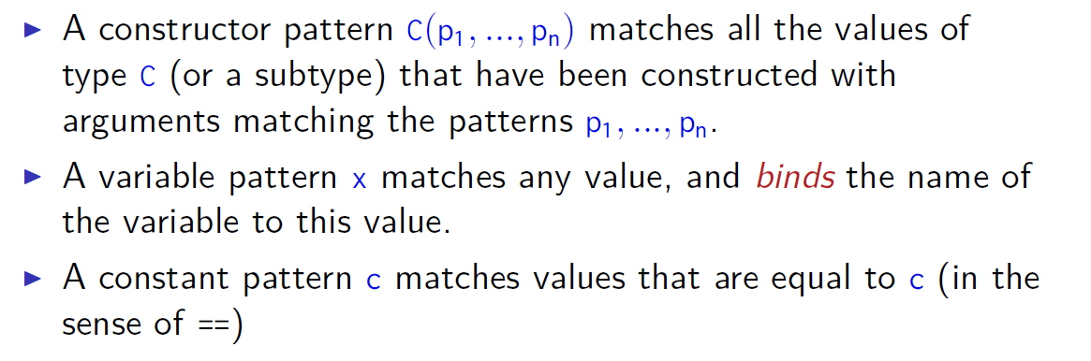
What Do Patterns Match?

Slide 59
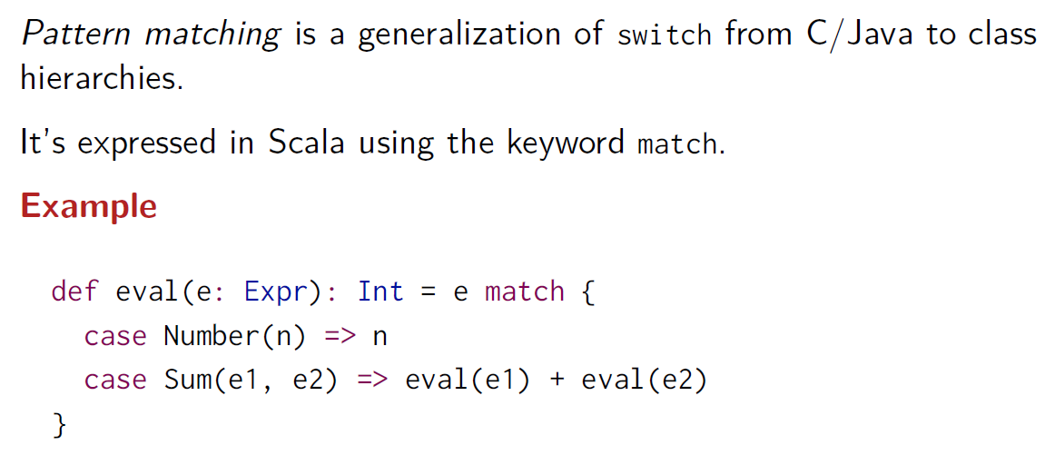
Pattern Matching

Slide 60




Slide 61
Thank you

